Slide 1
Pass by #value vs. pass by &reference
In Java
Homework / 19 February 2021

Slide 2
Before starting let’s recall the following:
Argument is the real value passed to the method.
Parameter is a named variable passed into a method.
add (1, 2);
int add (int a, int b) {
return (a+b);
}
arguments
parameters

Slide 3
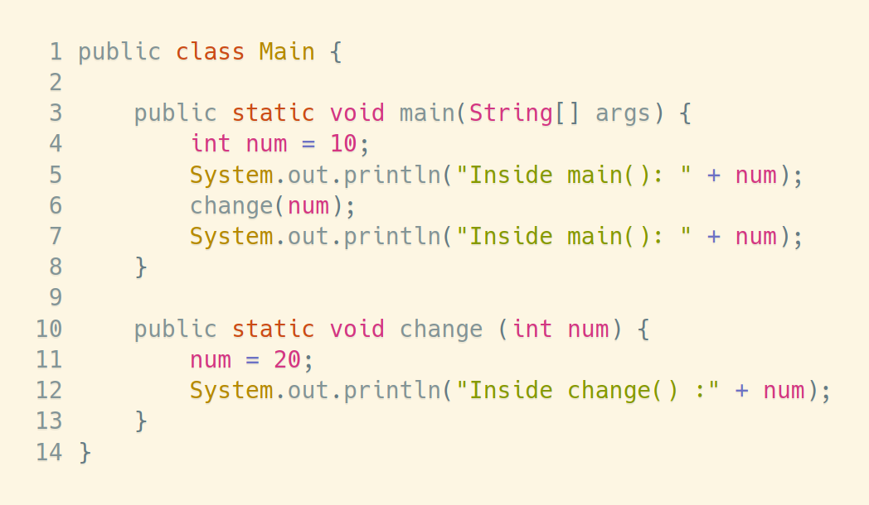
Pass by value
1
num
10
2
0x07FE
3
7
4
num
10
20
0x07FF
5
6

Slide 4
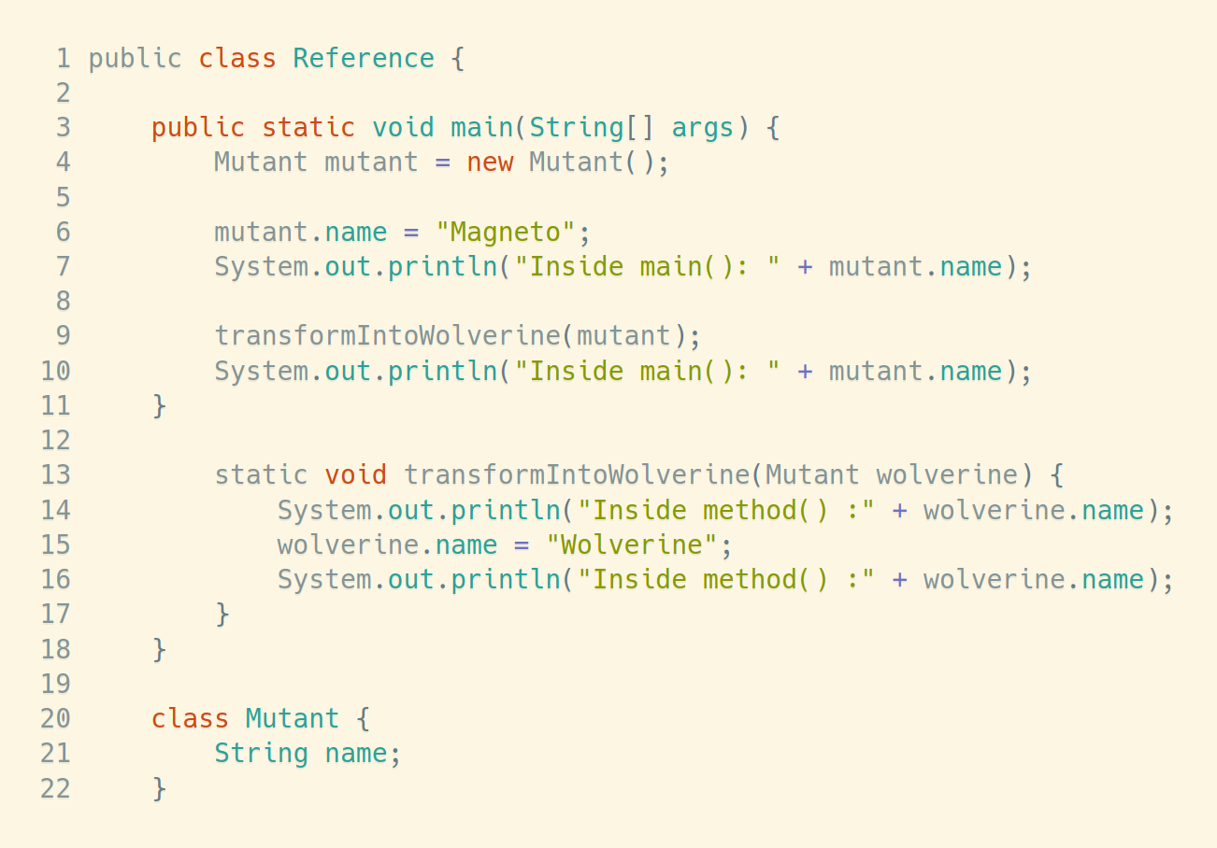
Pass by “reference” in Java
mutant
Stack address: 0x07FE
heap
1
3
heapAddr
0xB00B5
4
2
5
10
0xB00B5
7
Magneto
wolverine
Stack address: 0x07FF
Wolverine
6
8
heapAddr
0xB00B5
9

Slide 5
Pass by “reference” in Java
All object references in Java are passed by value.
This means that a copy of the value will be passed to a method.
However, passing a copy of the value also changes the real value of the object...
… because the stack holds the memory position (a reference) of the object on the heap.

Slide 6
Thank you

